Slide 1

Does [0] compute?
Dictionaries and Sets
Li Lei & Corey Carter
10-11-2017

Slide 2
Hashing table
Key
0 | 1 | 2 | 3 | 4 | 5 | 6 | 7 | 8 | 9
None | None | None | None | None | None | None | None | None | None
Value
Each position (Key) of the hash table can hold an item (Value)
Also called “Buckets”
Key:
unique
non-ordered
immutable
Fluent Python - Dictionaries and Sets
Notes:
LL

Slide 3
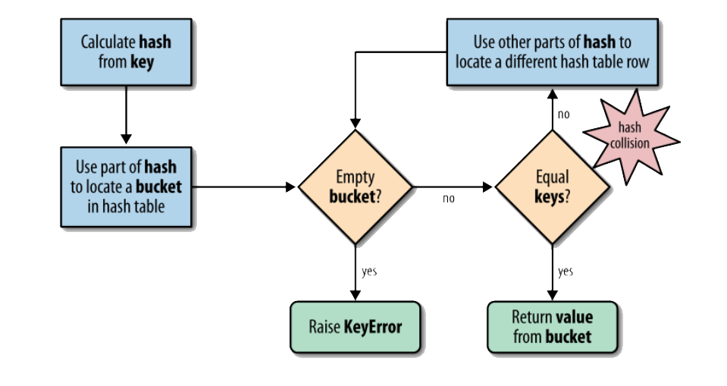
Hashing table algorithm
Fluent Python - Dictionaries and Sets
Notes:
LL

Slide 4
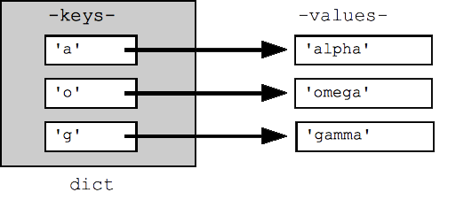
Dictionary Basics
Unique
Immutable
No restriction
Fluent Python - Dictionaries and Sets
Notes:
CC:
Dictionaries map keys, which can be any immutable type, to values, which can be any type.
Keys: unique and immutable
values: could be not unique and can be mutable

Slide 5
Hash Mapping Basics
>>> a = dict(one=1, two=2, three=3)
>>> b = {'one': 1, 'two': 2, 'three': 3}
>>> c = dict(zip(['one', 'two', 'three'], [1, 2, 3]))
>>> d = dict([('two', 2), ('one', 1), ('three', 3)])
>>> e = dict({'three': 3, 'one': 1, 'two': 2})
>>> a == b == c == d == e
True
Hashability makes an object usable as a dictionary key and a set member, because these data structures use the hash value internally.
- Python Glossary
Fluent Python - Dictionaries and Sets
Notes:
CC
Dictionaries can be defined in numerous ways.
Its hashablitiy allows for quick retrieval of information, by linking underlining hash values.

Slide 6
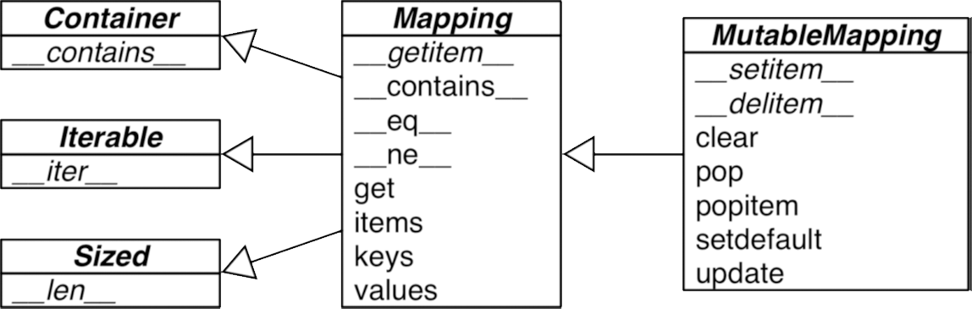
Generic Mapping Types
Fluent Python - Dictionaries and Sets
Notes:
CC
Creating your own dictionary class in your program allows for more flexibility and customization in your scripts. It also allows you to extend the basic functionality of the dictionary class.

Slide 7
Listcomps == dictcomps
>>> DIAL_CODES = [
... (86, ‘China’), 1
... (91, 'India'),
... (1, 'United States'),
... (62, 'Indonesia'),
... (55, 'Brazil'),
... (92, 'Pakistan'),
... (880, 'Bangladesh'),
... (234, 'Nigeria'),
... (7, 'Russia'),
... (81, 'Japan'),
... ]
>>> country_code = {country: code for code, country in DIAL_CODES} 2
>>> country_code
{'China': 86, 'India': 91, 'Bangladesh': 880, 'United States': 1,
'Pakistan': 92, 'Japan': 81, 'Russia': 7, 'Brazil': 55, 'Nigeria':
234, 'Indonesia': 62}
>>> {code: country.upper() for country, code in country_code.items() 3
... if code < 66}
{1: 'UNITED STATES', 55: 'BRAZIL', 62: 'INDONESIA', 7: 'RUSSIA'}
A list of pairs can be used directly with dict constructor.
Here the pairs are reversed: country is the key, and code is the value.
Reversing the pairs again, values uppercased and items filtered by code < 66.
Fluent Python - Dictionaries and Sets
Notes:
CC:
Dictcomps works similarly to list comprehensions.
A dictcomp builds a dict instance by producing key:value pair from any iterable.
Dictionary comprehensions to build two dictionaries from the same list of tuples.

Slide 8
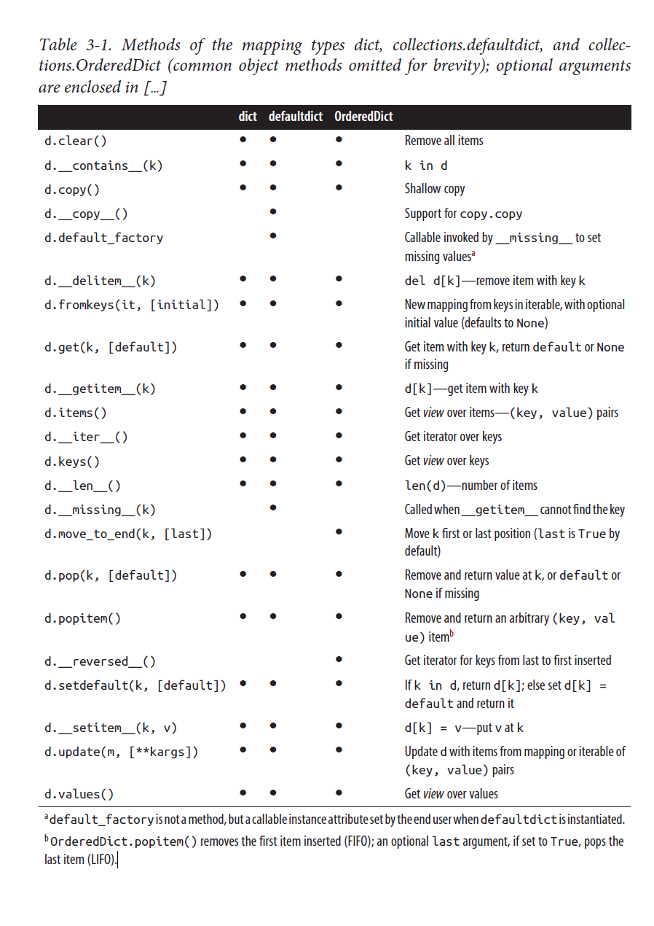
Useful Commands
Fluent Python - Dictionaries and Sets
Notes:
CC

Slide 9
Try set-defaults instead of try
"""Build an index mapping word -> list of occurrences"""
import sys
import re
WORD_RE = re.compile('\w+')
index = {}
Overview of Common Mapping Methods | 69
with open(sys.argv[1], encoding='utf-8') as fp:
for line_no, line in enumerate(fp, 1):
for match in WORD_RE.finditer(line):
word = match.group()
column_no = match.start()+1
location = (line_no, column_no)
index.setdefault(word, []).append(location) 1
# print in alphabetical order
for word in sorted(index, key=str.upper):
print(word, index[word])
Get the list of occurrences for word, or set it to [] if not found; set-default returns the value, so it can be updated without requiring a second search.
Fluent Python - Dictionaries and Sets
Notes:
CC:
This allows you to automatically create a dictionary keys, when one doesn’t exist. Which means no “index out of bounds” errors.

Slide 10
defaultdict: Another Take on Missing Keys
"""Build an index mapping word -> list of occurrences"""
import sys
import re
import collections
WORD_RE = re.compile('\w+')
index = collections.defaultdict(list) 1
with open(sys.argv[1], encoding='utf-8') as fp:
for line_no, line in enumerate(fp, 1):
for match in WORD_RE.finditer(line):
word = match.group()
column_no = match.start()+1
location = (line_no, column_no)
index[word].append(location) 2
# print in alphabetical order
for word in sorted(index, key=str.upper):
print(word, index[word])
Create a defaultdict with the list constructor as default_factory.
If word is not initially in the index, the default_factory is called to produce the missing value, which in this case is an empty list that is then assigned to index[word] and returned, so the .append(location) operation always succeeds.
Fluent Python - Dictionaries and Sets
Notes:
CC
*If no default_factory is provided, the usual KeyError is raised for missing keys.

Slide 11
The __missing__ Method
class StrKeyDict0(dict): 1
def __missing__(self, key):
if isinstance(key, str): 2
raise KeyError(key)
return self[str(key)] 3
def get(self, key, default=None):
try:
return self[key] 4
except KeyError:
return default 5
def __contains__(self, key):
return key in self.keys() or str(key) in self.keys() 6
StrKeyDict0 inherits from dict.
Check whether key is already a str. If it is, and it’s missing, raise KeyError.
Build str from key and look it up.
The get method delegates to __getitem__ by using the self[key] notation; that gives the opportunity for our __missing__ to act.
If a KeyError was raised, __missing__ already failed, so we return the default.
Search for unmodified key (the instance may contain non-str keys), then for a str built from the key.
Fluent Python - Dictionaries and Sets
Notes:
CC

Slide 12
Sub-Classing UserDict
import collections
class StrKeyDict(collections.UserDict):
def __missing__(self, key):
if isinstance(key, str):
raise KeyError(key)
return self[str(key)]
def __contains__(self, key):
return str(key) in self.data
def __setitem__(self, key, item):
self.data[str(key)] = item
StrKeyDict extends UserDict.
__missing__ is exactly as in Example 3-7.
__contains__ is simpler: we can assume all stored keys are str and we can check on self.data instead of invoking self.keys() as we did in StrKeyDict0.
__setitem__ converts any key to a str. This method is easier to overwrite when we can delegate to the self.data attribute.
Fluent Python - Dictionaries and Sets
Notes:
CC
The preferred method of creating user driven dictionary classes, due to its built in short-cuts that override. This allows for easy inherence into other sub or extend classes.

Slide 13
Variations of dict
collections.OrderedDict
Maintains keys in insertion order, allowing iteration over items in a predictable
order.
collections.ChainMap
Holds a list of mappings that can be searched as one. The lookup is performed on
each mapping in order, and succeeds if the key is found in any of them.
import builtins
pylookup = ChainMap(locals(), globals(), vars(builtins))
collections.Counter
A mapping that holds an integer count for each key. Updating an existing key adds
to its count. This can be used to count instances of hashable objects (the keys) or
as a multiset—a set that can hold several occurrences of each element. Counter
implements the + and - operators to combine tallies.
>>> ct = collections.Counter('abracadabra')
>>> ct
Counter({'a': 5, 'b': 2, 'r': 2, 'c': 1, 'd': 1})
>>> ct.update('aaaaazzz')
>>> ct
Counter({'a': 10, 'z': 3, 'b': 2, 'r': 2, 'c': 1, 'd': 1})
>>> ct.most_common(2)
[('a', 10), ('z', 3)]
Fluent Python - Dictionaries and Sets
Notes:
CC

Slide 14
Immutable Mappings
>>> from types import MappingProxyType
>>> d = {1: 'A'}
>>> d_proxy = MappingProxyType(d)
>>> d_proxy
mappingproxy({1: 'A'})
>>> d_proxy[1] 1
'A'
>>> d_proxy[2] = ‘x’ 2
Traceback (most recent call last):
File "<stdin>", line 1, in <module>
TypeError: 'mappingproxy' object does not support item assignment
>>> d[2] = 'B'
>>> d_proxy 3
mappingproxy({1: 'A', 2: 'B'})
>>> d_proxy[2]
'B'
>>>
Items in d can be seen through d_proxy.
Changes cannot be made through d_proxy.
d_proxy is dynamic: any change in d is reflected.
Fluent Python - Dictionaries and Sets
Notes:
CC
The mapping types provided by the standard library are all mutable, but you may need to guarantee that a user cannot change a mapping by mistake.

Slide 15
How dict works
Keys must be hashable objects
dict have significant memory overhead
Key search is very fast
Key ordering depends on insertion order
Adding items to a dict may change the order of existing keys
Fluent Python - Dictionaries and Sets
Notes:
LL

Slide 16
Set
Unordered
Unique
All values mutable
Fluent Python - Dictionaries and Sets
Notes:
LL

Slide 17
Frozen set
Unordered
Unique
All values immutable
Fluent Python - Dictionaries and Sets
Notes:
LL

Slide 18
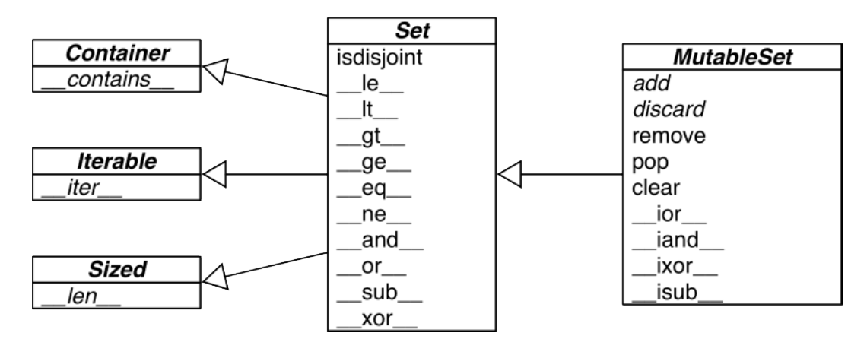
Set: operations
Fluent Python - Dictionaries and Sets
Notes:
LL

Slide 19
Set: operations
union: a | b
intersection: a & b
difference: a - b
Fluent Python - Dictionaries and Sets
Notes:
LL

Slide 20
Useful commands
Fluent Python - Dictionaries and Sets
Notes:
LL

Slide 21
Useful commands
Fluent Python - Dictionaries and Sets
Notes:
LL

Slide 22
Set comprehensions
Fluent Python - Dictionaries and Sets
Notes:
LL

Slide 23
Useful commands
Fluent Python - Dictionaries and Sets
Notes:
LL

Slide 24
Efficiency of set
Fluent Python - Dictionaries and Sets
Notes:
LL

Slide 25
How sets work?
Set elements must be hashable objects.
Sets have a significant memory overhead.
Membership testing is very efficient.
Element ordering depends on insertion order.
Adding elements to a set may change the order of other elements.
Fluent Python - Dictionaries and Sets
Notes:
LL

Slide 26
Group activity
Share one of the most important points you’ve learnt from this Chapter
How to incorporate this important point into your research?
Share one of the most difficult points you’ve learnt from this Chapter
Four mins discussion
Share with everyone via your group representatives
Fluent Python - Dictionaries and Sets
Notes:
LL

Slide 27
Questions?

